Slide 1
E-payment systems
To transfer money over the Internet
Methods of traditional payment
  Check, credit card, or cash
Methods of electronic payment
  Electronic cash, software wallets, smart cards, and credit/debit cards
  Scrip is digital cash minted by third-party organizations

Slide 2
Requirements for e-payments
Atomicity
  Money is not lost or created during a transfer
Good atomicity
  Money and good are exchanged atomically
Non-repudiation
  No party can deny its role in the transaction
  Digital signatures

Slide 3
Desirable Properties of Digital Money
Universally accepted
Transferable electronically
Divisible
Non-forgeable, non-stealable
Private (no one except parties know the amount)
Anonymous (no one can identify the payer)
Work off-line (no on-line verification needed)
No known system satisfies all.

Slide 4
E-Commerce Payment Systems
Different payment methods should be supported
Payment should be safe
Payment and delivery guaranteed
Example:
Online credit card payment, Smart Cards
  Secure protocols: SSL, SET
Internet payment systems
  Electronic cash, digital wallets
etc

Slide 5
Types of E-payments
E-cash
Electronic wallets
Smart card
Credit card

Slide 6
Electronic Cash
An anonymous cryptographic electronic money or electronic cash system.
Primary advantage is with purchase of items less than $10
  Credit card transaction fees make small purchases unprofitable
  Micropayments
    Payments for items costing less than $1
Notes:
eCash software on the user's local computer stored money in a digital format, cryptographically signed by a bank. The user could spend the digital money at any shop accepting eCash, without having to open an account with the vendor first, or transmitting credit card numbers. Security was ensured by public key digital signature schemes.

Slide 7
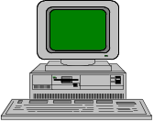
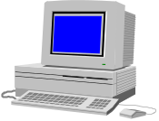
E-cash Concept
Merchant
1. Consumer buys e-cash from Bank
2. Bank sends e-cash bits to consumer (after
charging that amount plus fee)
3. Consumer sends e-cash to merchant
4. Merchant checks with Bank that e-cash
is valid (check for forgery or fraud)
5. Bank verifies that e-cash is valid
6. Parties complete transaction: e.g., merchant
present e-cash to issuing back for deposit
once goods or services are delivered
Consumer still has (invalid) e-cash
5
4
Bank
3
2
1
Consumer

Slide 8
Electronic Cash Issues
E-cash must allow spending only once
Must be anonymous, just like regular currency
  Safeguards must be in place to prevent counterfeiting
  Must be independent and freely transferable regardless of nationality or storage mechanism
Divisibility and Convenience
Complex transaction (checking with Bank)
  Atomicity problem

Slide 9
Two storage methods
On-line
  Individual does not have possession personally of electronic cash
  Trusted third party, e.g. online bank, holds customers’ cash accounts
Off-line
  Customer holds cash on smart card or software wallet
  Fraud and double spending require tamper-proof encryption
Notes:
Depending on the payment transactions, one distinguishes between on-line and off-line electronic cash: If the payee has to contact a third party (e.g., the bank or the credit-card company acting as an acquirer) before accepting a payment, the system is called an on-line system

Slide 10
Advantages and Disadvantages of Electronic Cash
Advantages
  More efficient, eventually meaning lower prices
  Lower transaction costs
  Anybody can use it, unlike credit cards, and does not require special authorization
Disadvantages
  Tax trail non-existent, like regular cash
  Money laundering
  Susceptible to forgery

Slide 11
Electronic Cash Security
Complex cryptographic algorithms prevent double spending
  Anonymity is preserved unless double spending is attempted
Serial numbers can allow tracing to prevent money laundering
  Does not prevent double spending, since the merchant or consumer could be at fault

Slide 12
Past and Present E-cash Systems
E-cash not popular in U.S., but successful in Europe and Japan
  Reasons for lack of U.S. success not clear
    Manner of implementation is too complicated
    Lack of standards and interoperable software that will run easily on a variety of hardware and software systems

Slide 13
Past and Present E-cash Systems
Checkfree
  Allows payment with online electronic checks
Clickshare
  Designed for magazine and newspaper publishers
  Used as a micropayment only system
  Purchases are billed to a user’s ISP, who in turn bill the customer

Slide 14
Past and Present E-cash Systems
CyberCash
  Combines features from cash and checks
  Offers credit card, micropayment, and check payment services
  Connects merchants directly with credit card processors to provide authorizations for transactions in real time
    No delays in processing, prevent insufficient e-cash to pay for the transaction
CyberCoins
  Stored in CyberCash wallet, a software storage mechanism located on customer’s computer
  Used to make purchases between .25c and $10
  PayNow -- payments made directly from checking accounts

Slide 15
Past and Present E-cash Systems
DigiCash
  Trailblazer in e-cash
  Allowed customers to purchase goods and services using anonymous electronic cash
  Recently entered Chapter 11 reorganization
Coin.Net
  Electronic tokens stored on a customer’s computer is used to make purchases
  Works by installing special plug-in to a customer’s web browser
  Merchants do not need special software to accept eCoins.
  eCoin server prevents double-spending and traces transactions, but consumer is anonymous to merchant

Slide 16
Past and Present E-cash Systems
MilliCent
  Developed by Digital, now part of Compaq
  Electronic scrip system
  Participating merchant creates and sells own scrip to broker at a discount
    Consumers register with broker and buy bulk generic scrip, usually with credit card
    Customers buy by converting broker scrip to vendor-specific scrip, i.e. scrip that a particular merchant will accept
  Customers can purchase items of very low value
  Brokers required for two reasons:
    Small payments require aggregation to insure profitability
    System is easier to use -- customer need only deal with one broker for all their scrip needs

Slide 17
Electronic Wallets
Stores credit card, electronic cash, owner’s identification and address
  Makes shopping easier and more efficient
    Eliminates need to repeatedly enter identifying information into forms to purchase
    Works in many different stores to speed checkout
  Amazon.com is one of the first online merchants to eliminate repeat form-filling for purchases

Slide 18
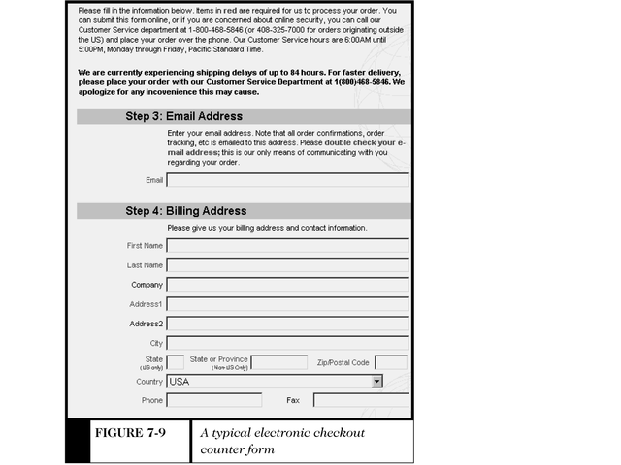
An Electronic Checkout Counter Form

Slide 19
Electronic Wallets
Agile Wallet
  Developed by CyberCash
  Allows customers to enter credit card and identifying information once, stored on a central server
  Information pops up in supported merchants’ payment pages, allowing one-click payment
eWallet
  Developed by Launchpad Technologies
  Free wallet software that stores credit card and personal information on users’ computer, not on a central server; info is dragged into payment form from eWallet
  Information is encrypted and password protected
  Works with Netscape and Internet Explorer

Slide 20
Electronic Wallets
Microsoft Wallet
  Comes pre-installed in earlier versions Internet Explorer, but not in Netscape
  All information is encrypted and password protected
  Microsoft Wallet Merchant directory shows merchants setup to accept Microsoft Wallet

Slide 21
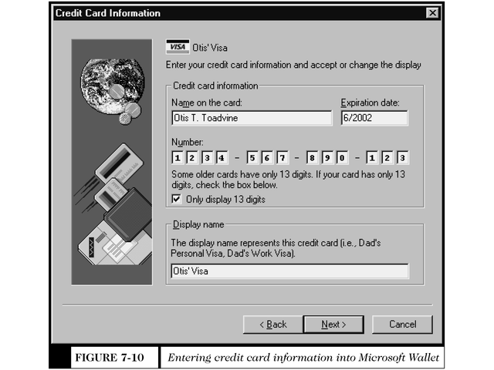
Entering Information Into Microsoft Wallet

Slide 22
Standard for Electronic Wallets
1. World Wide Web Consortium (W3C) is attempting to create an extensible and interoperable method of embedding micropayment information on a web page.
Client (consumer’s web browser) initiates micropayment activity
  Client browser includes Per Fee Link Handler module and one or more electronic wallets
  New HTML tags will carry micropayment information

Slide 23
Standard for Electronic Wallets
2. Electronic Commerce Modeling Language (ECML) proposed standards for electronic wallets
  Companies forming the consortium are America Online, IBM, Microsoft, Visa, and MasterCard
  Ultimate goal is for all commerce sites to accept ECML
  Unclear how this standard will incorporate privacy standards W3C set forth
  Electronic Commerce Modeling Language (ECML)
  Wallet/Merchant Standards Initiative, July 1999
  (Next four slides)

Slide 24
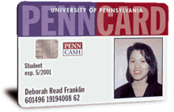
Smart Cards
Plastic card containing an embedded microchip
Available for over 20 years
Magnetic stripe
  140 bytes, cost $0.20-0.75
Memory cards
  1-4 KB memory, no processor, cost $1.00-2.50
Optical memory cards
  4 megabytes read-only (CD-like), cost $7.00-12.00
Microprocessor cards
  Embedded microprocessor
    (OLD) 8-bit processor, 16 KB ROM, 512 bytes RAM
    Equivalent power to IBM XT PC, cost $7.00-15.00
    32-bit processors now available
Notes:
52

Slide 25
Smart Card Applications
Ticketless travel
  Seoul bus system: 4M cards, 1B transactions since 1996
  Planned the SF Bay Area system
Authentication, ID
Medical records
Ecash
Store loyalty programs
Personal profiles
Government
  Licenses
Mall parking
. . .
Notes:
52

Slide 26
Advantages and Disadvantages of Smart Cards
Advantages:
  Atomic, debt-free transactions
  Feasible for very small transactions (information commerce)
  (Potentially) anonymous
  Security of physical storage
  (Potentially) currency-neutral
Disadvantages:
  Low maximum transaction limit (not suitable for B2B or most B2C)
  High Infrastructure costs (not suitable for C2C)
  Single physical point of failure (the card, issuer’s network)

Slide 27
Credit Cards
Credit card
  Used for the majority of Internet purchases
  Has a preset spending limit
  Currently most convenient method
  Most expensive e-payment mechanism
    MasterCard: $0.29 + 2% of transaction value
  Disadvantages
    Does not work for small amount (too expensive)
    Does not work for very large amount (too expensive)
Charge card
  No spending limit
  Entire amount charged due at end of billing period

Slide 28
Payment Acceptance and Processing
Merchants must set up merchant accounts to accept payment cards
Law prohibits charging payment card until merchandise is shipped
Payment card transaction requires:
  Merchant to authenticate payment card
  Merchant must check with card issuer to ensure funds are available and to put hold on funds needed to make current charge
  Settlement occurs in a few days when funds travel through banking system into merchant’s account

Slide 29
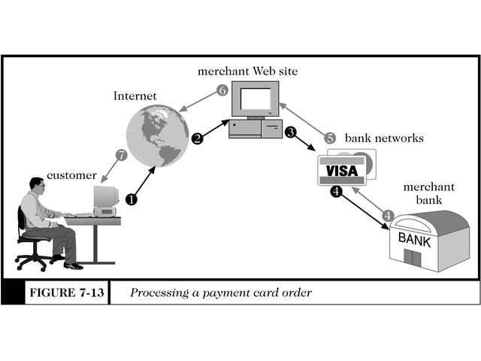
Processing a Payment Card Order

Slide 30
Open and Closed Loop Systems
Closed loop systems
  Banks and other financial institutions serve as brokers between card users and merchants -- no other institution is involved
  American Express and Discover are examples
Open loop systems
  Transaction is processed by third party
  Visa and MasterCard are examples

Slide 31
Setting Up Merchant Account
Merchant bank
  Also called acquiring bank
  Does business with merchants that want to accept payment cards
  Merchant receives account where they deposit card sales totals
  Value of sales slips is credited to merchant’s account

Slide 32
Processing Payment Cards Online
Can be done automatically by software packaged with electronic commerce software
Can contract with third party to handle payment card processing
  Can also pick, pack, and ship products to the customer
  Allows merchant to focus on web presence and supply availability

Slide 33
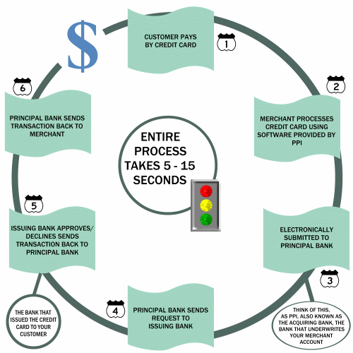
Credit Card Processing
SOURCE: PAYMENT
PROCESSING INC.

Slide 34
Payment Processing Services
Internetsecure
  Provides secure credit card payment services
  Supports payments with Visa and MasterCard
  Provides risk management and fraud detection, and ensures all proper security for credit card transactions is maintained
  Ensures all transactions are properly credited to merchant’s account

Slide 35
Payment Processing Services
Tellan
  Provides PCAuthorize for smaller commerce sites and WebAuthorize for larger enterprise-class merchant sites
  Both systems capture credit card information from the merchant’s form and connect directly to the bank network using dial-up or private, leased lines
  Bank network receives credit information, performs credit authorization, and deposits the money in the merchant’s bank account
  The merchant’s web site receives confirmation or rejection of the transaction, which is communicated to the customer

Slide 36
Payment Processing Services
IC Verify
  Provides electronic transaction processing for merchants for all major credit and debit cards
  Also allows check guarantees and verification transactions
  A CyberCash company
Authorize.Net
  Online, real time service that links merchants with issuing banks by simply inserting a small block of HTML code into their transaction page

Slide 37
Secure Electronic Transaction (SET) Protocol
Jointly designed by MasterCard and Visa with backing of Microsoft, Netscape, IBM, GTE, SAIC, and others
Designed to provide security for card payments as they travel on the Internet
  Contrasted with Secure Socket Layers (SSL) protocol, SET validates consumers and merchants in addition to providing secure transmission
SET specification
  Uses public key cryptography and digital certificates for validating both consumers and merchants
  Provides privacy, data integrity, user and merchant authentication, and consumer nonrepudiation

Slide 38
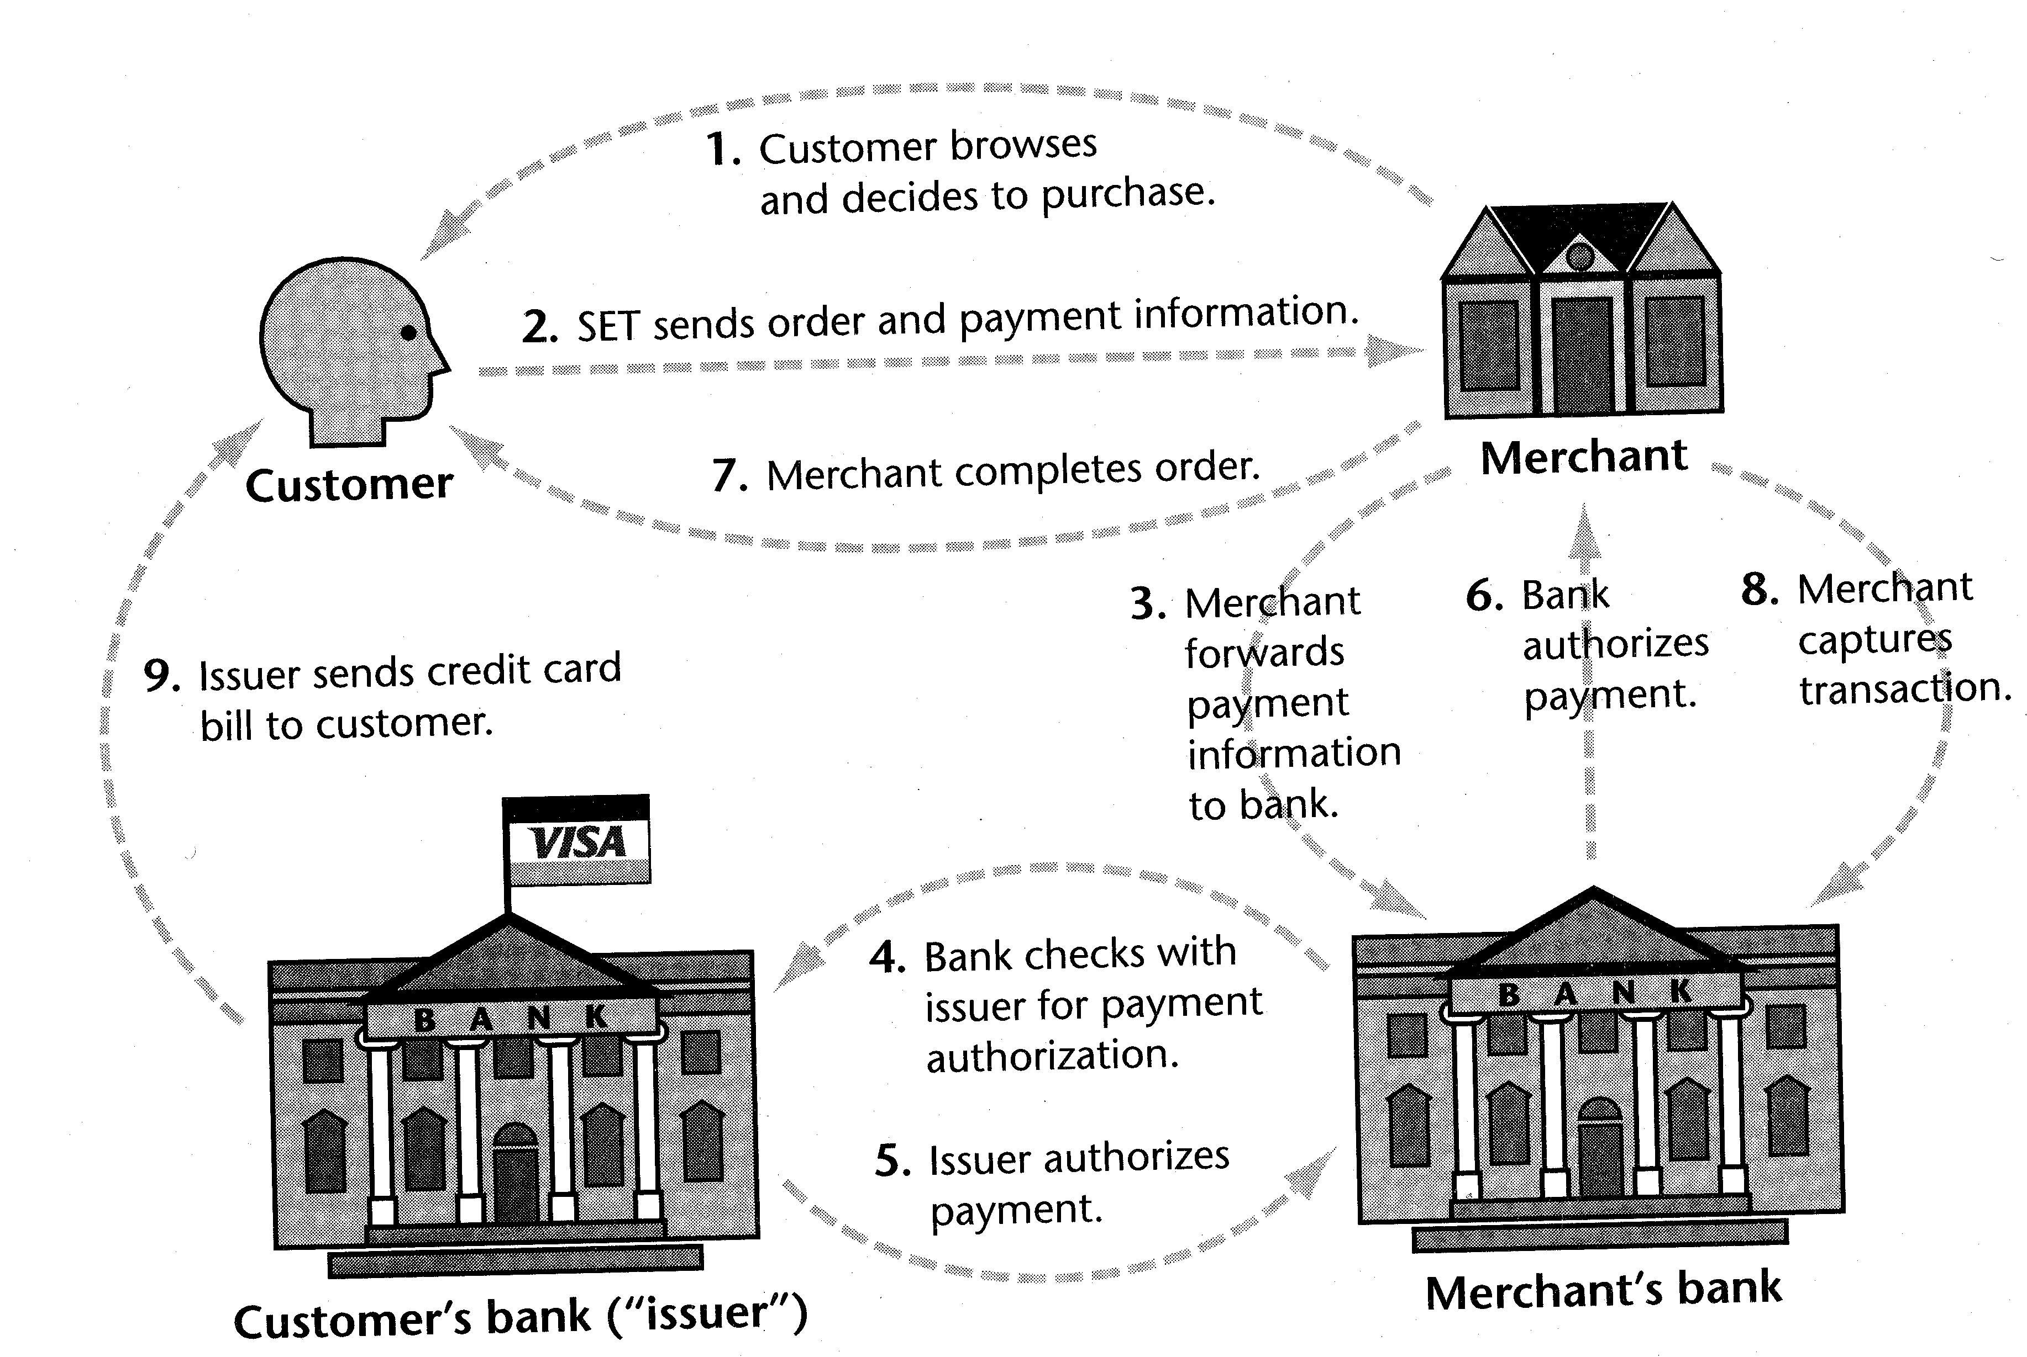
The SET protocol
The SET protocol coordinates the activities of the customer,
merchant, merchant’s bank, and card issuer. [Source: Stein]

Slide 39
SET Payment Transactions
SET-protected payments work like this:
  Consumer makes purchase by sending encrypted financial information along with digital certificate
  Merchant’s website transfers the information to a payment card processing center while a Certification Authority certifies digital certificate belongs to sender
  Payment card-processing center routes transaction to credit card issuer for approval
  Merchant receives approval and credit card is charged
  Merchant ships merchandise and adds transaction amount for deposit into merchant’s account

Slide 40
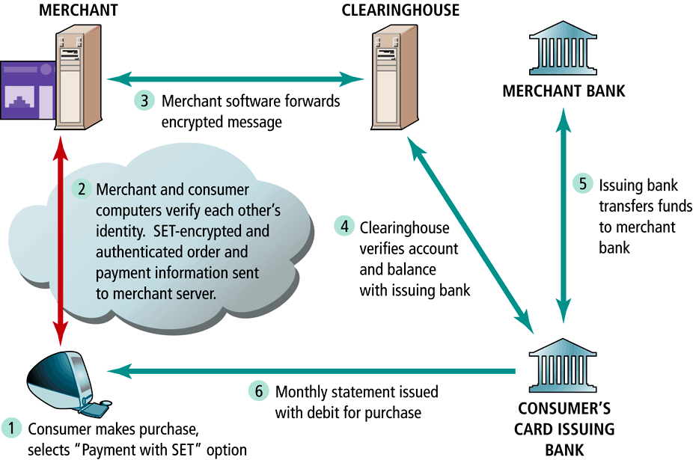
SET Transactions

Slide 41
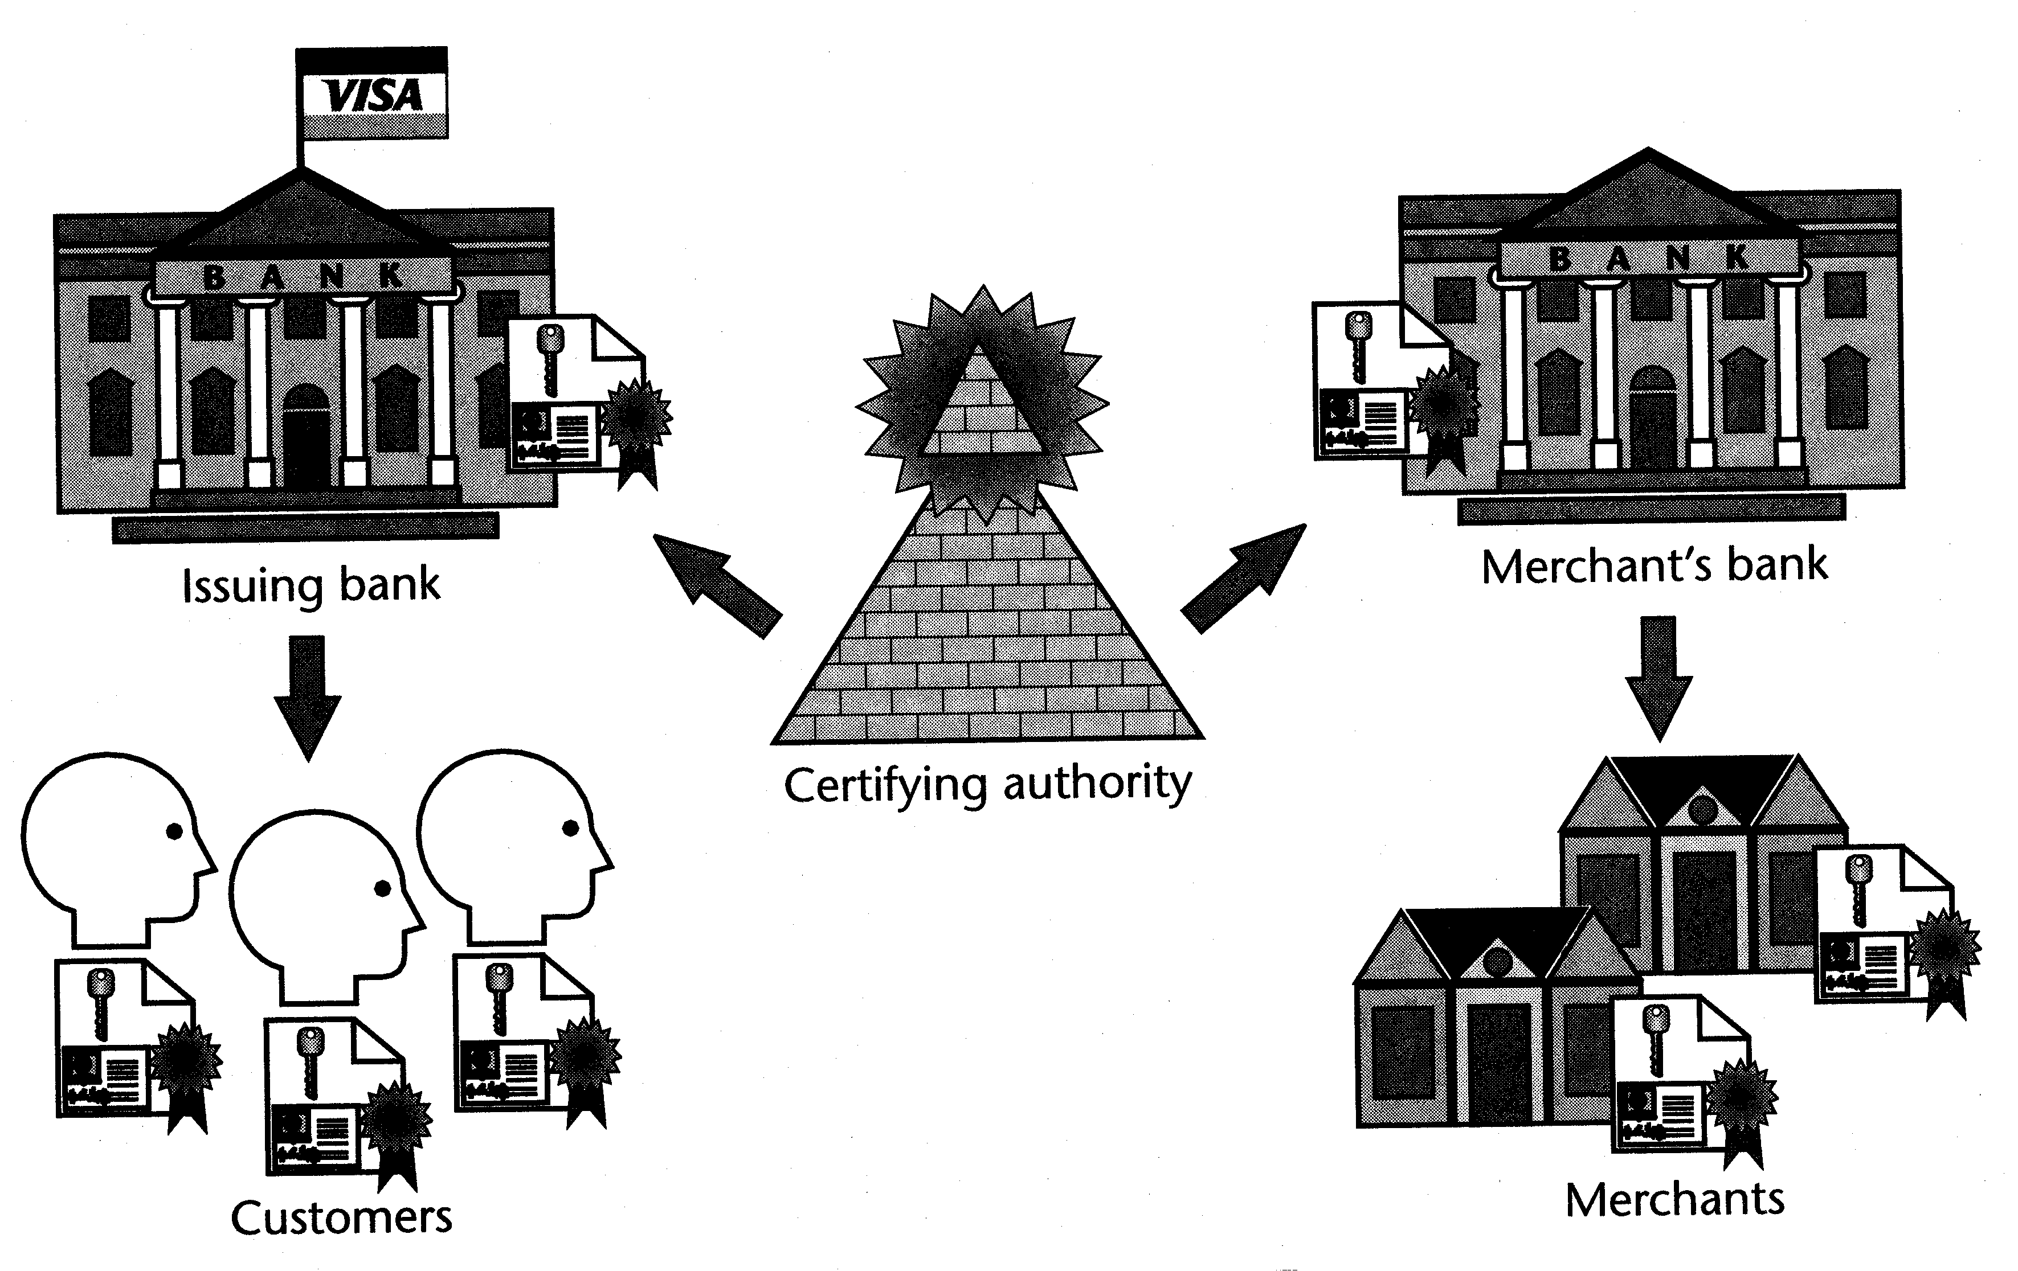
SET uses a hierarchy of trust
All parties hold certificates signed directly or
indirectly by a certifying authority. [Source: Stein]

Slide 42
SET Protocol
Extremely secure
  Fraud reduced since all parties are authenticated
  Requires all parties to have certificates
So far has received lukewarm reception
80 percent of SET activities are in Europe and Asian countries
Problems with SET
  Not easy to implement
  Not as inexpensive as expected
  Expensive to integrated with legacy applications
  Not tried and tested, and often not needed
  Scalability is still in question

Slide 43
Q&A

